Slide 1
UNIX PROCESSES
INTRODUCTION
A Process is a program under execution in a UNIX or POSIX system.
A process, in simple terms, is an instance of a running program. The operating system tracks processes through a five-digit ID number known as the pid or the process ID.
A program/command when executed, a special instance is provided by the system to the process. This instance consists of all the services/resources that may be utilized by the process under execution.
Whenever a command is issued in unix/linux, it creates/starts a new process. For example, pwd when issued which is used to list the current directory location the user is in, a process starts.
Through a 5 digit ID number unix/linux keeps account of the processes, this number is call process id or pid. Each process in the system has a unique pid.
Used up pid’s can be used in again for a newer process since all the possible combinations are used.
At any point of time, no two processes with the same pid exist in the system because it is the pid that Unix uses to track each process.
PROF. SYED MUSTAFA, HKBKCE

Slide 2
A process can be run as:
Foreground Process : Every process when started runs in foreground by default, receives input from the keyboard and sends output to the screen.
When issuing pwd command
$ ls pwd
Output:
$ /home/geeksforgeeks/root
When a command/process is running in the foreground and is taking a lot of time, no other processes can be run or started because the prompt would not be available until the program finishes processing and comes out.

Slide 3
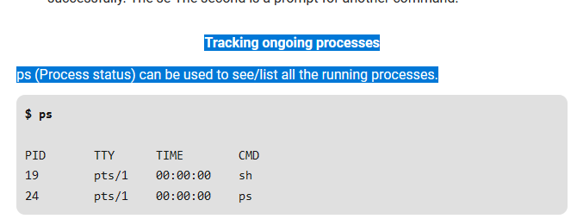
Tracking ongoing processes
ps (Process status) can be used to see/list all the running processes.

Slide 4
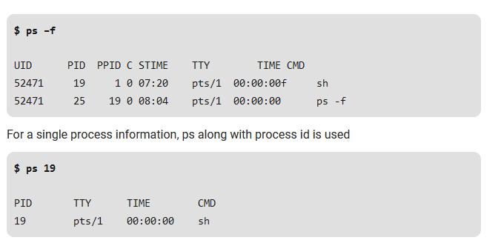
For More information

Slide 5
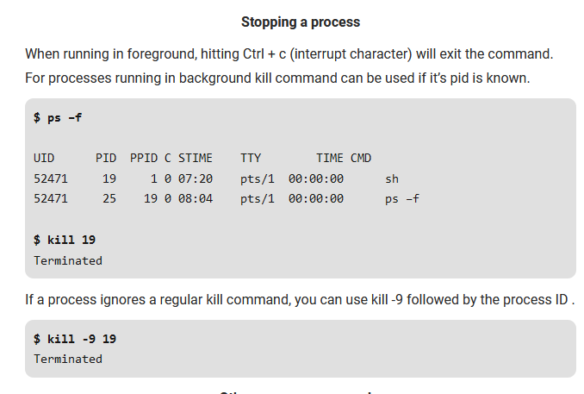

Slide 6
Types of Processes
1) Parent and Child process : The 2nd and 3rd column of the ps –f command shows process id and parent’s process id number. For each user process there’s a parent process in the system, with most of the commands having shell as their parent.
2) Zombie and Orphan process : After completing its execution a child process is terminated or killed and SIGCHLD updates the parent process about the termination and thus can continue the task assigned to it. But at times when the parent process is killed before the termination of the child process, the child processes becomes orphan processes, with the parent of all processes “init” process, becomes their new ppid.
A process which is killed but still shows its entry in the process status or the process table is called a zombie process, they are dead and are not used.

Slide 7
main FUNCTION
A C program starts execution with a function called main.
The prototype for the main function is
int main(int argc, char *argv[]);
where argc is the number of command-line arguments, and argv is an array of pointers to the arguments.
When a C program is executed by the kernel by one of the exec functions, a special start-up routine (creates heap/malloc work) is called before the main function is called.
The executable program file specifies this routine as the starting address for the program.
This is set up by the link editor when it is invoked by the C compiler.
This start-up routine takes values from the kernel, the command-line arguments and the environment and sets things up so that the main function is called.

Slide 8
UNIT 4 UNIX PROCESSES
PROCESS TERMINATION
There are eight ways for a process to terminate.
Normal termination occurs in five ways:
Return from main
Calling exit
Calling _exit or _Exit
Return of the last thread from its start routine
Calling pthread_exit from the last thread
Abnormal termination occurs in three ways:
Calling abort
Receipt of a signal
Response of the last thread to a cancellation request
The exit() function performs some cleaning before terminating the program. It clears the connection termination, buffer flushes etc. This _Exit() function does not clean anything.
PROF. SYED MUSTAFA, HKBKCE

Slide 9
main function returns integer value by default. if zero is returned as exit status to indicate to Operating system that the program worked successfully without any compile time or run time errors. if a non zero value(1 mostly) is returned to indicate some error happened in program execution.
exit()
The function exit() is used to terminate the calling function immediately without executing further processes. As exit() function calls, it terminates processes.
#include <stdio.h>
#include <stdlib.h>
int main()
{
int x = 10;
printf("The value of x : %d\n", x);
exit(0);
printf("Calling of exit()");
return 0;}
In the above program, a variable ‘x’ is initialized with a value. The value of variable is printed and exit() function is called. As exit() is called, it exits the execution immediately and it does not print the statement in the printf(). The calling of exit() is as follows −

Slide 10
UNIT 4 UNIX PROCESSES
Exit Functions
Three functions terminate a program normally:
_exit and _Exit, which return to the kernel immediately, and
exit, which performs certain cleanup processing and then returns to the kernel.
#include <stdlib.h>
void void
exit(int status);
_Exit(int status);
#include <unistd.h>
void _exit(int status);
All three exit functions expect a single integer argument, called the exit status. Returning an integer value from the main function is equivalent to calling exit with the same value.
Thus exit(0) is the same as return(0) from the main function.
PROF. SYED MUSTAFA, HKBKCE

Slide 11
UNIT 4 UNIX PROCESSES
Exit Functions
Three functions terminate a program normally:
_exit and _Exit, which return to the kernel immediately, and
exit, which performs certain cleanup processing and then returns to the kernel.
#include <stdlib.h>
void void
exit(int status);
_Exit(int status);
#include <unistd.h>
void _exit(int status);
All three exit functions expect a single integer argument, called the exit status. Returning an integer value from the main function is equivalent to calling exit with the same value.
Thus exit(0) is the same as return(0) from the main function.
PROF. SYED MUSTAFA, HKBKCE

Slide 12
UNIT 4 UNIX PROCESSES
int main()
{
printf(“HKBKCE”); return(5);
}
$ cc demo.c
$ ./a.out HKBKCE
$ echo $? // print the exit status
5
PROF. SYED MUSTAFA, HKBKCE
130

Slide 13
UNIT 4 UNIX PROCESSES
atexit Function
With ISO C, a process can register up to 32 functions that are automatically called by exit. These are called exit handlers and are registered by calling the atexit function.
#include <stdlib.h>
int atexit(void (*func)(void));
returns: 0 if OK, nonzero on error
This declaration says that we pass the address of a function as the argument to atexit.
When this function is called, it is not passed any arguments and is not expected to return a value.
The exit function calls these functions in reverse order of their registration.
Each function is called as many times as it was registered.
PROF. SYED MUSTAFA, HKBKCE

Slide 14
UNIT 4 UNIX PROCESSES
Example of exit handlers
static void my_exit1(void); static void my_exit2(void); int main(void) { if (atexit(my_exit2) != 0) perror("can't register my_exit2"); if (atexit(my_exit1) != 0) perror("can't register my_exit1"); printf("main is done\n"); return(0); } | static void my_exit1(void) { printf("first exit handler\n"); } static void my_exit2(void) { printf("second exit handler\n"); } Output: $ ./a.out main is done first exit handler second exit handler
PROF. SYED MUSTAFA, HKBKCE

Slide 15
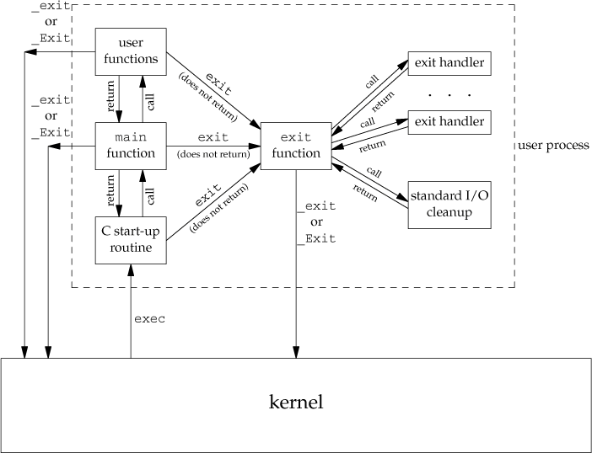
UNIT 4 UNIX PROCESSES
How a C program is started and the various ways it can terminate
PROF. SYED MUSTAFA, HKBKCE

Slide 16
C startup routine - It is a set of execution startup routines linked into a C program that performs any initialization work required before calling the program's main function.

Slide 17
UNIT 4 UNIX PROCESSES
COMMAND-LINE ARGUMENTS
It is possible to pass some values from the command line to your C programs when they are executed. These values are called command line arguments,
When a program is executed, the process that does the exec can pass command-line arguments to the new program.
Example: Echo all command-line arguments to standard output
int main(int argc, char *argv[])
{
int i;
for (i = 0; i < argc;i++) /* echo all command-line args */
printf("argv[%d]: %s\n", i, argv[i]);
exit(0);
}
Output:
$ ./echoarg arg1 TEST foo
argv[0]: ./echoarg
argv[1]: arg1
argv[2]: TEST
argv[3]: foo
PROF. SYED MUSTAFA, HKBKCE

Slide 18
UNIT 4 UNIX PROCESSES
MEMORY LAYOUT OF A C PROGRAM
Historically, a C program has been composed of the following pieces:
Text segment:
It is known as code segment it contains the executable instructions or contains the machine code of the compiled program.
The machine instructions that the CPU executes.
Usually, the text segment is sharable so that only a single copy needs to be in memory for frequently executed programs, such as text editors, the C compiler, the shells, and so on.
Also, the text segment is often read-only, to prevent a program from accidentally
modifying its instructions.
Initialized data segment:
usually called simply the data segment, containing variables that are specifically initialized in the program.
For example, the C declaration
int maxcount = 99;
appearing outside any function causes this variable to be stored in the initialized data segment with its initial value.
PROF. SYED MUSTAFA, HKBKCE

Slide 19
UNIT 4 UNIX PROCESSES
MEMORY LAYOUT OF A C PROGRAM
Uninitialized data segment:
Often called the "bss" segment, named after an ancient assembler operator that stood for
"block started by symbol."
Data in this segment is initialized by the kernel to arithmetic 0 or null pointers before the program starts executing.
The C declaration
long sum[1000];
appearing outside any function causes this variable to be stored in the uninitialized data
segment.
PROF. SYED MUSTAFA, HKBKCE

Slide 20
UNIT 4 UNIX PROCESSES
MEMORY LAYOUT OF A C PROGRAM
Stack:
Used to store all local variables and is used for passing arguments to functions along with the return address of instruction which is to be executed next once function call is over . All recursive function call are added to stack.
where local or automatic variables are stored, along with information that is saved each time a function is called.
Each time a function is called, the address of where to return to and certain information about the caller's environment, such as some of the machine registers, are saved on the stack.
The newly called function then allocates room on the stack for its automatic and temporary variables.
This is how recursive functions in C can work.
Each time a recursive function calls itself, a new stack frame is used, so one set of variables doesn't interfere with the variables from another instance of the function.
PROF. SYED MUSTAFA, HKBKCE

Slide 21
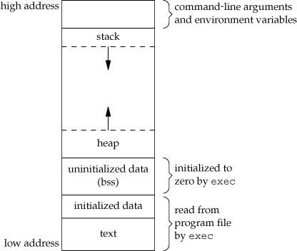
UNIT 4 UNIX PROCESSES
MEMORY LAYOUT OF A C PROGRAM
Heap:
where dynamic memory allocation usually takes place.
Historically, the heap has been located between the uninitialized data and the stack.
PROF. SYED MUSTAFA, HKBKCE

Slide 22
Shared Libraries
Shared library remove the common library routines from the executable file instead maintaining a single copy of library somewhere in memory that all processes reference.
This reduces size of each executable file.
Advantage – shared library is that library functions can be replaced with new versions without having to relink edit every program that uses the library.

Slide 23
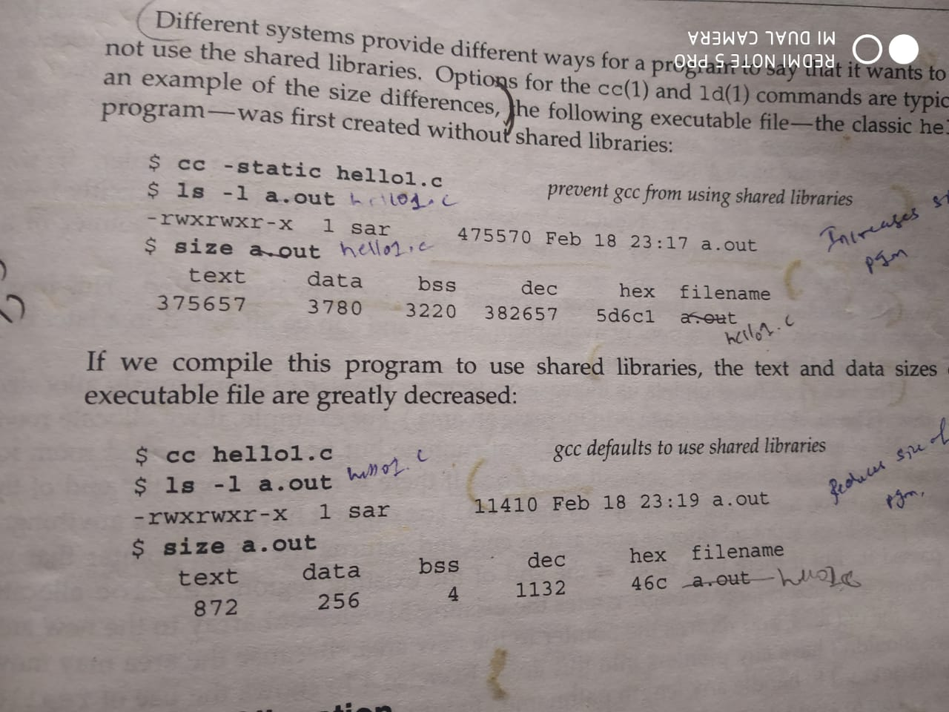

Slide 24
MEMORY ALLOCATION
an array is a collection of a fixed number of values. Once the size of an array is declared, you cannot change it.
Sometimes the size of the array you declared may be insufficient. To solve this issue, you can allocate memory manually during run-time. This is known as dynamic memory allocation in C programming.
To allocate memory dynamically, library functions are malloc(), calloc(), realloc() and free() are used. These functions are defined in the <stdlib.h> header file.

Slide 25
UNIT 4 UNIX PROCESSES
MEMORY ALLOCATION
ISO C specifies three functions for memory allocation:
malloc:
which allocates a specified number of bytes of memory. The initial value of the memory is
indeterminate.
calloc:
which allocates space for a specified number of objects of a specified size. The space is initialized to all 0 bits.
realloc:
which increases or decreases the size of a previously allocated area.
When the size increases, it may involve moving the previously allocated area somewhere else, to provide the additional room at the end. Also, when the size increases, the initial value of the space between the old contents and the end of the new area is indeterminate.
PROF. SYED MUSTAFA, HKBKCE
140

Slide 26
UNIT 4 UNIX PROCESSES
MEMORY ALLOCATION
#include <stdlib.h>
void *malloc(size_t size);
void *calloc(size_t nobj, size_t size);
void *realloc(void *ptr, size_t newsize);
On success, it returns: non-null pointer , NULL on Error.
void free(void *ptr);
The function free causes the space pointed to by ptr to be deallocated.
This freed space is usually put into a pool of available memory and can be allocated in a later call to one of the three alloc functions.
.
PROF. SYED MUSTAFA, HKBKCE

Slide 27
C malloc() method
“malloc” or “memory allocation” method in C is used to dynamically allocate a single large block of memory with the specified size.
ptr = (int*) malloc(100 * sizeof(int));
Since the size of int is 2 bytes, this statement will allocate 200 bytes of memory. And, the pointer ptr holds the address of the first byte in the allocated memory.

Slide 28
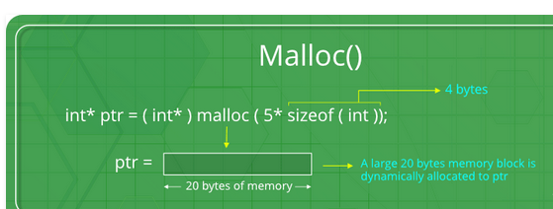

Slide 29
#include <stdio.h>
#include <stdlib.h>
int main()
{
// This pointer will hold the
// base address of the block created
int* ptr;
int n, i;
// Get the number of elements for the array
n = 5;
printf("Enter number of elements: %d\n", n);
// Dynamically allocate memory using malloc()
ptr = (int*)malloc(n * sizeof(int));

Slide 30
// Check if the memory has been successfully
// allocated by malloc or not
if (ptr == NULL) {
printf("Memory not allocated.\n");
exit(0);
}
else {
// Memory has been successfully allocated
printf("Memory successfully allocated using malloc.\n");
// Get the elements of the array
for (i = 0; i < n; ++i) {
ptr[i] = i + 1;
}
// Print the elements of the array
printf("The elements of the array are: ");
for (i = 0; i < n; ++i) {
printf("%d, ", ptr[i]);
}
}
return 0;
}

Slide 31
Output:
Enter number of elements: 5
Memory successfully allocated using malloc.
The elements of the array are: 1, 2, 3, 4, 5,

Slide 32
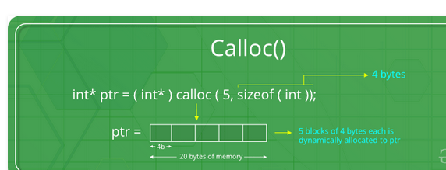
“calloc” or “contiguous allocation” method in C is used to dynamically allocate the specified number of blocks of memory of the specified type. It initializes each block with a default value ‘0’.
ptr = (float*) calloc(5, sizeof(float));
This statement allocates contiguous space in memory for 25 elements each with the size of the float.

Slide 33
#include <stdio.h>
#include <stdlib.h>
int main()
{
// This pointer will hold the
// base address of the block created
int* ptr;
int n, i;
// Get the number of elements for the array
n = 5;
printf("Enter number of elements: %d\n", n);
// Dynamically allocate memory using calloc()
ptr = (int*)calloc(n, sizeof(int));
// Check if the memory has been successfully
// allocated by calloc or not
if (ptr == NULL) {
printf("Memory not allocated.\n");
exit(0);
}

Slide 34
else {
// Memory has been successfully allocated
printf("Memory successfully allocated using calloc.\n");
// Get the elements of the array
for (i = 0; i < n; ++i) {
ptr[i] = i + 1; }
// Print the elements of the array
printf("The elements of the array are: ");
for (i = 0; i < n; ++i) {
printf("%d, ", ptr[i]);
}
} return 0; }
Enter number of elements:
5
Memory successfully allocated using calloc.
The elements of the array are: 1, 2, 3, 4, 5,

Slide 35
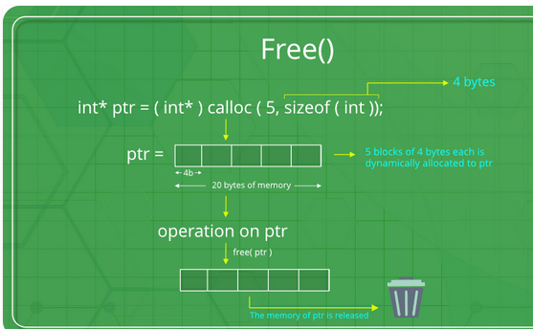
“free” method in C is used to dynamically de-allocate the memory. The memory allocated using functions malloc() and calloc() is not de-allocated on their own. Hence the free() method is used, whenever the dynamic memory allocation takes place. It helps to reduce wastage of memory by freeing it.
free(ptr);

Slide 36
#include <stdio.h>
#include <stdlib.h>
int main()
{ // This pointer will hold the
// base address of the block created
int *ptr, *ptr1;
int n, i;
// Get the number of elements for the array
n = 5;
printf("Enter number of elements: %d\n", n);
// Dynamically allocate memory using malloc()
ptr = (int*)malloc(n * sizeof(int));
// Dynamically allocate memory using calloc()
ptr1 = (int*)calloc(n, sizeof(int));
// Check if the memory has been successfully
// allocated by malloc or not
if (ptr == NULL || ptr1 == NULL) {
printf("Memory not allocated.\n");
exit(0);
}

Slide 37
else {
// Memory has been successfully allocated
printf("Memory successfully allocated using malloc.\n");
// Free the memory
free(ptr);
printf("Malloc Memory successfully freed.\n");
// Memory has been successfully allocated
printf("\nMemory successfully allocated using calloc.\n");
// Free the memory
free(ptr1);
printf("Calloc Memory successfully freed.\n");
} return 0;
}

Slide 38
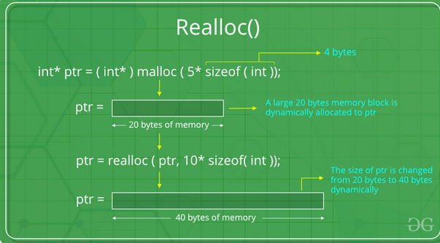
“realloc” or “re-allocation” method in C is used to dynamically change the memory allocation of a previously allocated memory. In other words, if the memory previously allocated with the help of malloc or calloc is insufficient, realloc can be used to dynamically re-allocate memory.
ptr = realloc(ptr, newSize);
where ptr is reallocated with new size 'newSize'.

Slide 39
#include <stdio.h>
#include <stdlib.h>
int main()
{ // This pointer will hold the
// base address of the block created
int* ptr;
int n, i;
// Get the number of elements for the array
n = 5;
printf("Enter number of elements: %d\n", n);
// Dynamically allocate memory using calloc()
ptr = (int*) calloc(n, sizeof(int));
// Check if the memory has been successfully
// allocated by malloc or not
if (ptr == NULL) {
printf("Memory not allocated.\n");
exit(0);
} else {
// Memory has been successfully allocated
printf("Memory successfully allocated using calloc.\n");
// Get the elements of the array
for (i = 0; i < n; ++i) {
ptr[i] = i + 1;
}

Slide 40
// Print the elements of the array
printf("The elements of the array are: ");
for (i = 0; i < n; ++i) {
printf("%d, ", ptr[i]);
}
// Get the new size for the array
n = 10;
printf("\n\nEnter the new size of the array: %d\n", n);
// Dynamically re-allocate memory using realloc()
ptr = realloc(ptr, n * sizeof(int));
// Memory has been successfully allocated
printf("Memory successfully re-allocated using realloc.\n");
// Get the new elements of the array
for (i = 5; i < n; ++i) {
ptr[i] = i + 1;
}
// Print the elements of the array
printf("The elements of the array are: ");
for (i = 0; i < n; ++i) {
printf("%d, ", ptr[i]);
}
free(ptr);
}
return 0;
}

Slide 41
Enter number of elements: 5
Memory successfully allocated using calloc.
The elements of the array are: 1, 2, 3, 4, 5,
Enter the new size of the array: 10
Memory successfully re-allocated using realloc.
The elements of the array are: 1, 2, 3, 4, 5, 6, 7, 8, 9, 10,

Slide 42
Environment Variables
They are part of the operating environment in which a process runs. For example, a running process can query the value of the TEMP environment variable to discover a suitable location to store temporary files, or the HOME or USERPROFILE variable to find the directory structure owned by the user running the process.
Environment variables control the behavior of the system. They determine the environment in which you work.
General form
variable=string
Examples:
HOME=/usr1/stevens
Few Environmental Variables are : CDPATH, COLUMNS, EDITOR, ENV, HISTFILE, HISTSIZE, HOME, LINES, LOGNAME, MAIL, MAILCHECK, MAILPATH, OLDPWD, PATH, PS1, PS2, PS3, PS4, PWD, RANDOM, REPLY, SECONDS, SHELL, TERM, TMOUT, VISUAL
Environment List:
Comprises list of Environment Variables.

Slide 43
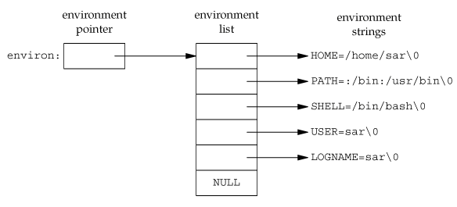
UNIT 4 UNIX PROCESSES
ENVIRONMENT LIST
Each program is also passed an environment list.
Like the argument list, the environment list is an array of character pointers, with each pointer containing the address of a null-terminated C string.
The address of the array of pointers is contained in the global variable environ:
extern char **environ;
Generally any environmental variable is of the form: name=value.
135

Slide 44
Accessing Environment list
External variable named environ
External variable named environ can be used to access the environment list
extern char **environ;
Function getenv()

Slide 45
Program to display environment variables using 3 ways
#include<iostream>
#include<stdlib.h>
using namespace std;
int main( int argc , char *argv[] , char *envp[] )
{
//Using Environmant Variable passed to program as command line arguments
cout<<"\n = = = = = = = = = = = = = = = = = = = = = = = = = = ";
cout<<"\n\n Using Environment Varialbles passed to command line arguments \n\n EnvironmentVariable=Value format \n\n";
for ( int i = 0 ; envp[i] != (char *) 0 ; i++ )
{
cout<<envp[i]<<"\n";
}

Slide 46
cout<<"\n = = = = = = = = = = = = = = = = = = = = = = = = = = ";
cout<<"\n\n Using getenv , stdlib.h \n\n";
//print Environment variable using getenv
char *env = getenv("HOME");
cout<<"PATH=" << env << "\n";
char envVar[10][10] = {"SHELL","TERM","USER","PATH"};
for ( int i = 0 ; i < 4 ; i++ )
{
cout << envVar[i] <<"=" << getenv(envVar[i]) << "\n";
}

Slide 47
cout<<"\n = = = = = = = = = = = = = = = = = = = = = = = = = = ";
cout<<"\n\n Using external variable environ \n\n";
extern char **environ;
for( int i = 0 ; environ[i] != ( char * ) 0 ; i++ )
{
cout<<environ[i]<<"\n";
}
cout<<"\n = = = = = = = = = = = = = = = = = = = = = = = = = = ";
return 0;
}

Slide 48
UNIT 4 UNIX PROCESSES
ENVIRONMENT VARIABLES
The environment strings are usually of the form: name=value.
The functions that we can use to set and fetch values from the variables are setenv, putenv, and getenv functions.
The prototype of these functions are:
#include <stdlib.h>
char *getenv(const char *name);
Returns: pointer to value associated with name, NULL if not found.
Eg:
char *res=getenv(“HOME”);
cout<<“HOME=“<<res<<endl;
output:
HOME=/home/syed
PROF. SYED MUSTAFA, HKBKCE

Slide 49
UNIT 4 UNIX PROCESSES
ENVIRONMENT VARIABLES
int putenv(char *str);
int setenv(const char *name, const char *value, int rewrite);
int unsetenv(const char *name);
All return: 0 if OK, nonzero on error.
The putenv function takes a string of the form name=value and places it in the
environment list.
If name already exists, its old definition is first removed.
PROF. SYED MUSTAFA, HKBKCE

Slide 50
UNIT 4 UNIX PROCESSES
ENVIRONMENT VARIABLES
int setenv(const char *name, const char *value, int rewrite);
All return: 0 if OK, nonzero on error.
The setenv function sets name to value.
If name already exists in the environment, then
if rewrite is nonzero, the existing definition for name is removed;
if rewrite is 0, an existing definition for name is not removed, name is not set to the new value, and no error occurs.
PROF. SYED MUSTAFA, HKBKCE

Slide 51
UNIT 4 UNIX PROCESSES
ENVIRONMENT VARIABLES
int unsetenv(const char *name);
All return: 0 if OK, nonzero on error.
The unsetenv function removes any definition of name. It is not an error if such a definition does not exist.
PROF. SYED MUSTAFA, HKBKCE

Slide 52
UNIT 4 UNIX PROCESSES
Setjmp() & longjmp() FUNCTIONS
In C, we can't goto a label that's in another function.
Instead, we must use the setjmp and longjmp functions to perform this type of branching.
#include <setjmp.h>
int setjmp(jmp_buf env);
Returns: 0 if called directly, nonzero if returning from a call to longjmp
void longjmp(jmp_buf env, int val);
The setjmp function records or marks a location in a program code so that later when the longjmp function is called from some other function, the execution continues from the location onwards.
The env variable(the first argument) records the necessary information needed to continue execution.
The env is of the jmp_buf defined in <setjmp.h> file, it contains the task.
PROF. SYED MUSTAFA, HKBKCE

Slide 53
Setjmp- places the book mark.
Longjmp- goes to where bookmark was placed.

Slide 54
#include<stdio.h>
Jmp_buf resume_here;
Int main()
{
  if setjmp(resume_here)
  {
  Printf(“After longjmp back in main()”);
  Printf(“jmp buffer variable resume here”);
  }
  Else{ printf(“setjmp returns first time “);
  hello();
  } }

Slide 55
Void hello()
{ hello1();
}
hello1()
{
Printf(“setjmp returns first time ”);
longjmp(resume_here,1);
Printf(“cant be reached here because I did longjmp”);
}

Slide 56
Output
setjmp returns first time
setjmp returns first time
After longjmp back in main()
jmp buffer variable resume here
When setjmp called first time returns value zero and hence else clause is executed . This time setjmp returned value 1 passed by longjmp and if clause is executed.

Slide 57
Write a program for division of 2 numbers using setjmp and longjmp function. Make setjmp() for first time with test condition == 0 , its true and call division() to perform division of 2 numbers but if denominator is 0 call the longjmp function with value 1 to execute the else part with “divide by zero error”

Slide 58
UNIT 4 UNIX PROCESSES
Setjmp() & longjmp() FUNCTIONS
#include <stdio.h> #include <setjmp.h> jmp_buf jb; int main(int argc, char *argv[]) { int a, b, c; printf ("Give two numbers for division : "); scanf("%d %d", &a, &b); // 5 and 0 if(setjmp(jb) == 0) { c = division(a, b); printf ("%d / %d = %d", a, b, c); return 0; } else { handle_error(); return -1; } } | int division(int a, int b) { if(b == 0) longjmp(jb, 1); else return (a/b); } void handle_error(void) { printf("Divide by zero error !"); }
PROF. SYED MUSTAFA, HKBKCE

Slide 59
UNIT 4 UNIX PROCESSES
getrlimit() AND setrlimit() FUNCTIONS
Every process has a set of resource limits, some of which can be queried and changed by the getrlimit and setrlimit functions.
It allows process to read and set limits on the system resources that it can consume.
#include <sys/resource.h>
int getrlimit(int resource, struct rlimit *rlptr);
int setrlimit(int resource, const struct rlimit *rlptr);
Both return: 0 if OK, nonzero on error
Each call to these two functions specifies a single resource and a pointer to the following structure:
struct rlimit
{
rlim_t rlim_cur; /* soft limit: current limit */
rlim_t rlim_max; /* hard limit: maximum value for rlim_cur */
};
PROF. SYED MUSTAFA, HKBKCE
150

Slide 60
UNIT 4 UNIX PROCESSES
getrlimit() AND setrlimit() FUNCTIONS
Three rules govern the changing of the resource limits.
A process can change its soft limit to a value less than or equal to its hard limit.
A process can lower its hard limit to a value greater than or equal to its soft limit.
Only a super user process can raise or change a hard limit.
An infinite limit is specified by the constant RLIM_INFINITY.

Slide 61
UNIT 4 UNIX PROCESSES
Resource Argument takes one of the following values.
 | RLIMIT_AS | The maximum size in bytes of a process's total available memory.
 | RLIMIT_CORE | The maximum size in bytes of a core file. A limit of 0 prevents the creation of a core file.
 | RLIMIT_CPU | The maximum amount of CPU time in seconds. When the soft limit is exceeded, the SIGXCPU signal is sent to the process.
 | RLIMIT_DATA | The maximum size in bytes of the data segment: the sum of the initialized data, uninitialized data, and heap.
 | RLIMIT_FSIZE | The maximum size in bytes of a file that may be created. When the soft limit is exceeded, the process is sent the SIGXFSZ signal.
 | RLIMIT_LOCKS | The maximum number of file locks a process can hold.
 | RLIMIT_NOFILE | The maximum number of open files per process. Changing this limit affects the value returned by the sysconf function for its _SC_OPEN_MAX argument
 | RLIMIT_NPROC | The maximum number of child processes per real user ID. Changing this limit affects the value returned for _SC_CHIL^{PR}D^{OF}_^{. S}M^{YED}A^{MU}X^{STA}b^{FA}y^{, H}t^{K}h^{BK}e^{CE} sysconf function ¹⁵¹

Slide 62
Int main()
{
Struct rlimit r1;
Getrlimit (RLIMIT_CPU, &r1);
//set CPU limit of 1 second
R1.rlim_cur=1;
Setrlimit(RLIMIT_CPU,&r1);
Return 0;
}

Slide 63
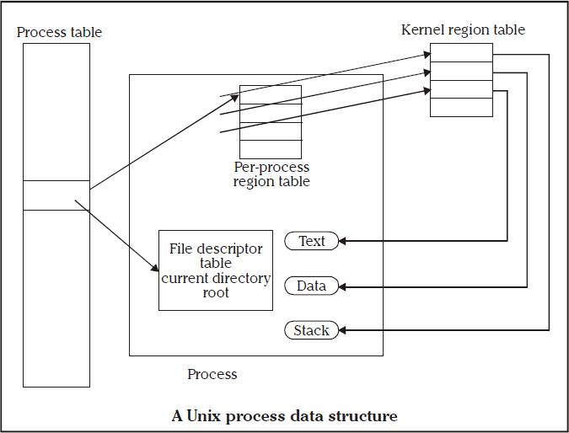
UNIT 4 UNIX PROCESSES
UNIX KERNEL SUPPORT FOR PROCESS
PROF. SYED MUSTAFA, HKBKCE

Slide 64
UNIT 4 UNIX PROCESSES
UNIX KERNEL SUPPORT FOR PROCESS
UNIX kernel has a process table that keeps track of all active process present in the system. Some of these processes belongs to the kernel and are called as “system process”.
Every entry in the process table contains pointers to the text, data and the stack segments and also to U-area of a process.
Text seg- machine executable instructions, data seg- contain static and global variables, stack seg- contains run time stack, automatic variables, return address of all active functions.
U-area of a process is an extension of the process table entry and contains other process specific data such as the file descriptor table, current root and working directory inode numbers and set of system imposed process limits.
All processes in UNIX system expect the process that is created by the system boot code, are created by the fork system call.
PROF. SYED MUSTAFA, HKBKCE

Slide 65
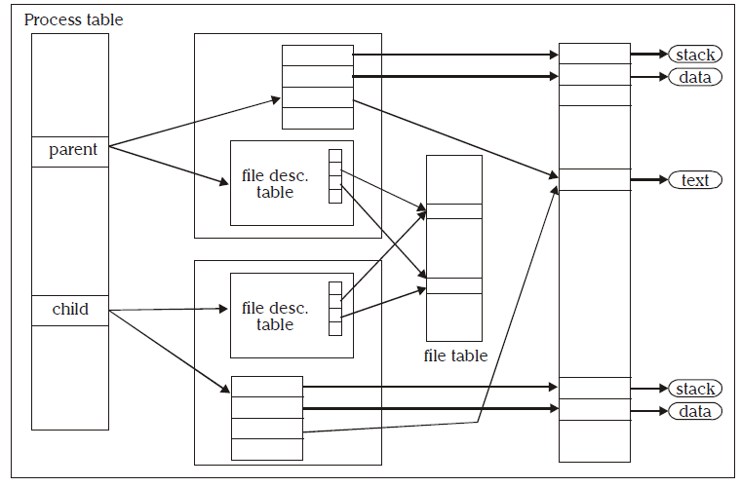
UNIT 4 UNIX PROCESSES
UNIX KERNEL SUPPORT FOR PROCESS
After the fork system call, once the child process is created, both the parent and child processes resumes execution.
When a process is created by fork, it contains duplicated copies of the text, data and stack segments of its parent as shown in the Figure below.
Also it has a file descriptor table, which contains reference to the same opened files as the parent, such that they both share the same file pointer to each opened files.

Slide 66
UNIT 4 UNIX PROCESSES
UNIX KERNEL SUPPORT FOR PROCESS
The process will be assigned with attributes, which are either inherited from its parent or will be set by the kernel.
Attributes | Meaning
real user identification number (rUID) | the user ID of a user who created the parent process
real group identification number (rGID) | the group ID of a user who created that parent process
effective user identification number (eUID) | this allows the process to access and create files with the same privileges as the program file owner.
effective group identification number (eGID) | this allows the process to access and create files with the same privileges as the group to which the program file belongs.
Saved set-UID and saved set-GID | these are the assigned eUID and eGID of the process respectively
Process group identification number (PGID) and session identification number (SID) | these identify the process group and session of which the process is member
Supplementary group identification numbers | this is a set of additional group IDs for a user who created the process PROF. SYED MUSTAFA, HKBKCE 156

Slide 67
UNIT 5 PROCESS CONTROL
fork FUNCTION
An existing process can create a new one by calling the fork function.
#include <unistd.h>
pid_t fork(void);
Returns: 0 in child, process ID of child in parent, 1 on error.
The new process created by fork is called the child process.
This function is called once but returns twice.
The only difference in the returns is that the return value in the child is 0, whereas the return value in the parent is the process ID of the new child.
PROF. SYED MUSTAFA, HKBKCE

Slide 68
UNIT 5 PROCESS CONTROL
fork FUNCTION
Example programs:
Program 1
/* Program to demonstrate fork function Program name – fork1.c */
#include<unistd.h>
void main( )
{
fork( );
printf(“\n hello USP”);
}
Output :
$ cc fork1.c
$ ./a.out
hello USP
hello USP
Note : The statement hello USP is executed twice as both the child and parent have executed that instruction.
PROF. SYED MUSTAFA, HKBKCE

Slide 69
UNIT 5 PROCESS CONTROL
fork FUNCTION
Example programs:
Program 2 /* Program name – fork2.c */
#include<unistd.h>
void main( )
{
printf(“\n 6 sem “);
fork( );
printf(“\n hello USP”);
}
Output :
$ cc fork2.c
$ ./a.out
6 sem
hello USP
hello USP
Note: The statement 6 sem is executed only once by the parent because it is called before fork and statement hello USP is
executed twice by child and parent.
PROF. SYED MUSTAFA, HKBKCE

